Slide 1
Group 12:
Visualization and Aggregation
By: Steven Cai, Joann Mei, Kevin Li, Mehak Chohan, Nafisa Kibria

Slide 2

Outline
Issues and Solution
Data Visualizations
Data Visualizations
Pivot tables

Slide 3
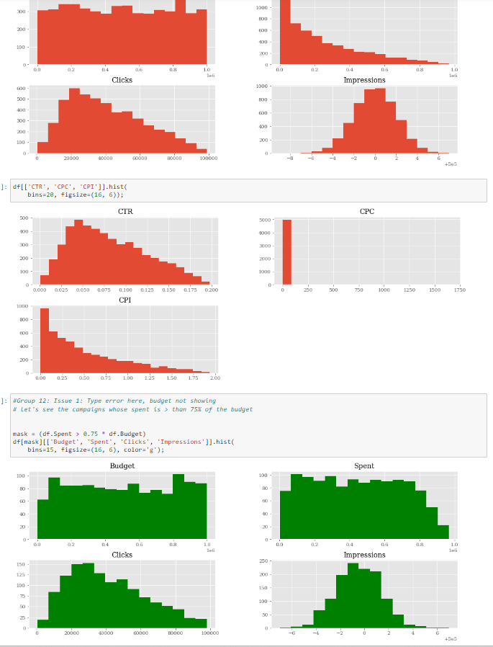
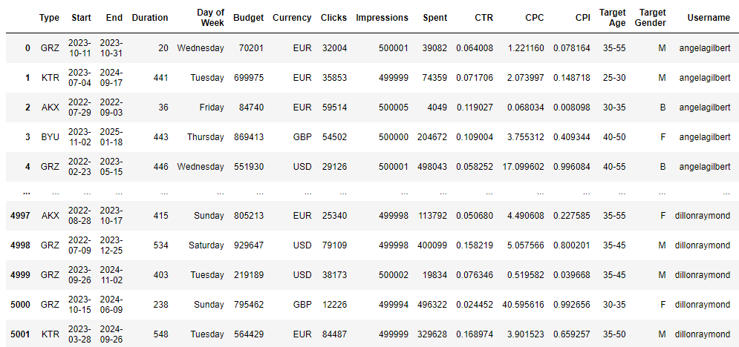
Step 5: Visualization and Aggregation
Goal: Visualize campaign metrics impressions, clicks, budget, and spent through histograms, line plots, pivottables, and data aggregation.
Notes:
My name’s Joann Mei, and As Steven had introduced, the last step of the Ad Campaign project is visualization and aggregation. Here, we explore and apply the capabilities of pandas and numpy to take a large dataset and create data visualizations out of them and aggregating the data to summarize and make it understandable. During this step, we take full advantage of pylab and matplotlib, to plot and display them in the cell output frame, respectively. In order to visualize and aggregate, we pick things up from where teams 1-10 left off from preparing, cleaning, and manipulating the dataframe as we’re creating a variety of charts and dataplots based on the data prepared before.
By the end of this step, we will have histograms based on the ad campaign metrics such as budget, spendings, clicks, and impressions; as well as measures based off the data: Click through rate CTR, Cost per click CPC, and Cost per impression CPI. For further data visualization, we hope to have working histograms that display how much of campaign spendings have expended over 75% of the budget; frequency line plots for impressions, spendings, and clicks; and aggregating the data to create pivot tables in order to understand the relationship of the metrics to target gender and age based on mean and standard deviation. First things first however, we ran into a couple errors that prohibited the plots from being displayed correctly and accurately on the first run so our groups main goal was to address those issues first.
[OMITTING]
Import matplotlib to display the plots in the cell output from Pandas, and pylab to plot.
Display the table of data that we're trying to display, such as budget, spendings, clicks, impressions, and any measures based off those.
Create histograms for the data we’re trying to display, beginning with ad interactions and budgets.
Create histograms for the measures off the ad campaign, CTR, CPC, CPI.
Create histograms for portions of budget, spendings, clicks, and impressions that that only expended up to 75% of the budget
Create line plots for impressions, spendings, and clicks.
Creating a dictionary calculating the mean and standard deviation of ad average impressions and spendings based on gender and age.
Creating a

Slide 4
Import matplotlib to display the plots in the cell output from Pandas, and pylab to plot.
Instruct python to import
Display the table of data that we're trying to display, such as budget, spendings, clicks, impressions, and any measures based off those.
Create histograms for the data we’re trying to display, beginning with ad interactions and budgets.
Create histograms for the measures off the ad campaign, CTR, CPC, CPI.
Create histograms for portions of budget, spendings, clicks, and impressions that only expended more than 75% of the budget
Create line plots for impressions, spendings, and clicks.
Creating a dictionary calculating the mean and standard deviation of ad average impressions and spendings based on gender and age.
Creating a

Slide 5
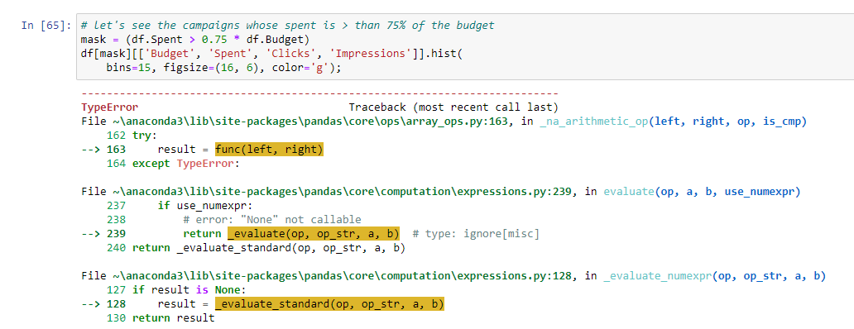
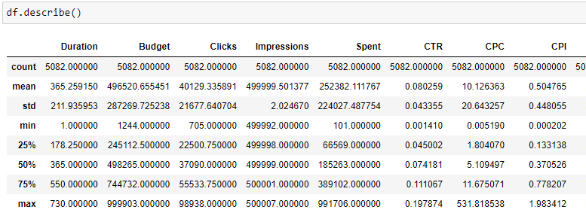
Issue 1: Budget not plottable
Notes:
The first issue with the code was one that we immediately noticed when our team first ran the code. When trying to calculate histograms based on the campaigns where spendings were more than 75% of budget, python wasn’t able to plot nor display anything. To address this, we first had to see what was the reason for the error. Thankfully, python tells us at the end of the error output that it’s because python can’t make a histogram from mask since it can’t multiply a sequence by a non-integer. This is strange as the dataframe described three cells above displayed all numerical values with no error..

Slide 6
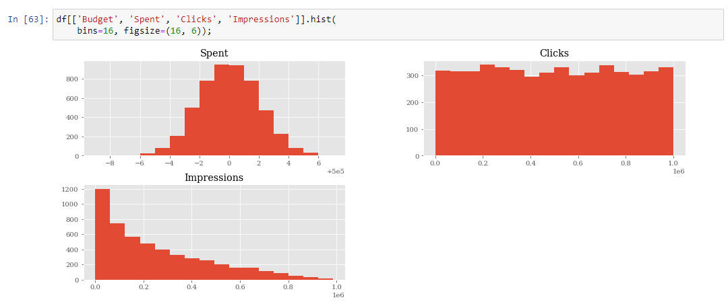
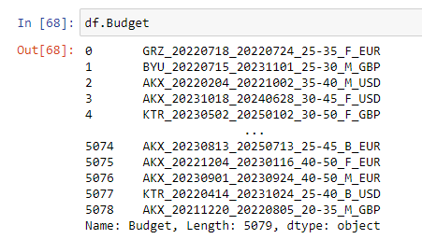
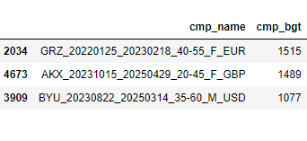
Tracing the error..
Budget, Spent, Clicks, Impressions = 4
}
Only Spent, Clicks, Impressions displayed = ¾ histograms
Notes:
In order to help identify the source of the error, we reviewed the histograms prior that was able to plot and print successfully.. We saw that in the first set of histograms, only 3 of the 4 dataframes were displayed. On the slide, I pointed out that there was also a histogram meant to be made for Budget, but it wasn’t displayed in the cell output. Our first step was seeing what made Budget nonplottable, and this was simply done by inserting a cell above and printing out df.Budget, to which we saw Budget was an object dataframe. When we take a look at what made up of the dataframe, it appears that the integers originally in cmp_budget was replaced by the string objects from the cmp_name dataframe.

Slide 7
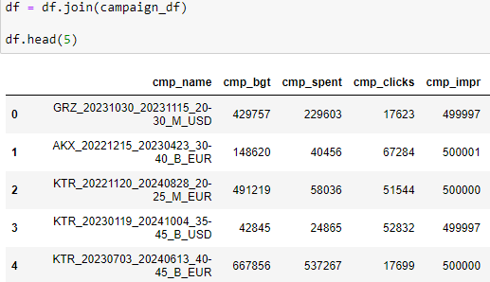
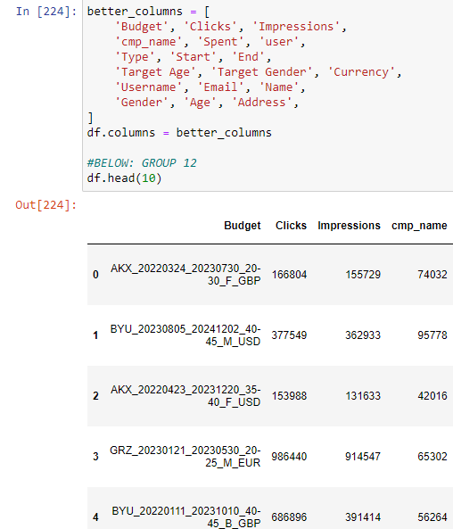
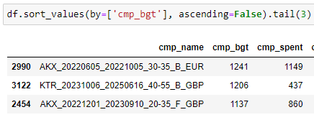
Tracing the error…
2. Cleaning the data - data is fine
3 - Manipulating the DataFrame
> objects get swapped
Notes:
Now that we at least knew why Budget was not plottable, we had to track down where the objects in cmp_name and cmp_budget was switched. We saw that the last time that cmp_budget was appropriately an integer database was in section 2 of the code, and it wasn’t until when the dataframe was manipulated in section 3 that the dataframe objects swapped.

Slide 8
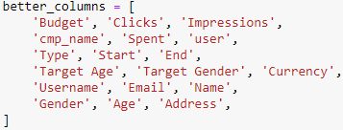
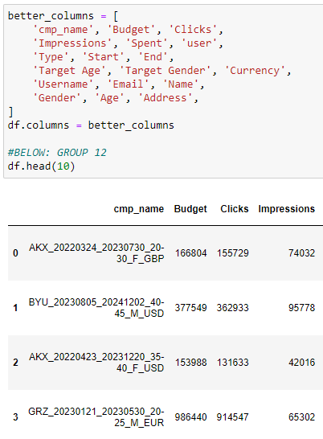
Fixing the error…
2. Cleaning the data - data is fine
3 - Manipulating the DataFrame
> objects get swapped
Notes:
A simple fix was by changing the order of the column names so that it was consistent with the columns from Step 2: Cleaning the Data, meaning the error came from renaming the columns in Step 3, serving as an example to us how Python will execute code exactly as written so we need to be careful and pay attention to what we’re writing. By fixing this subtle mistake, we were able to run the rest of our part in Step 5 and the budget histogram was successfully displayed. However, there were additional errors that needed to be addressed before we could feel confident about our data visualizations and aggregations, which Kevin will cover next.

Slide 9
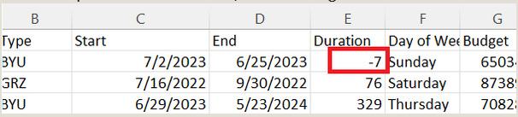
Issue 2: Duration Bug
Notes:
There is bug with duration where it shows up as negative, most easily seen when exported to excel

Slide 10
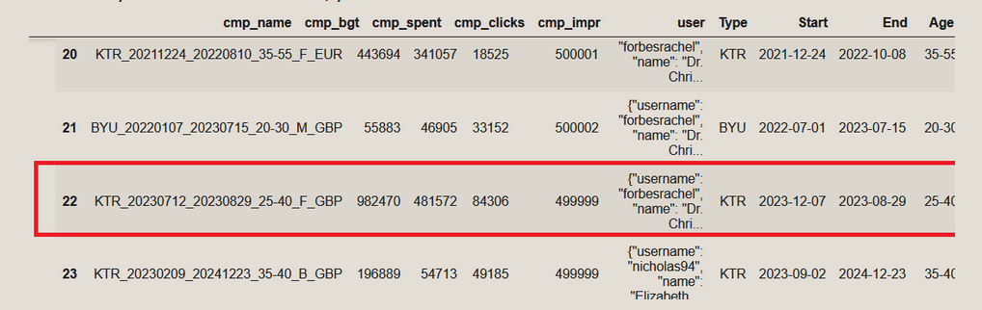
Start: 20230712 -> 2023-12-07
End: 20230829-> 2023-08-29
Notes:
Month and Day are switched around

Slide 11
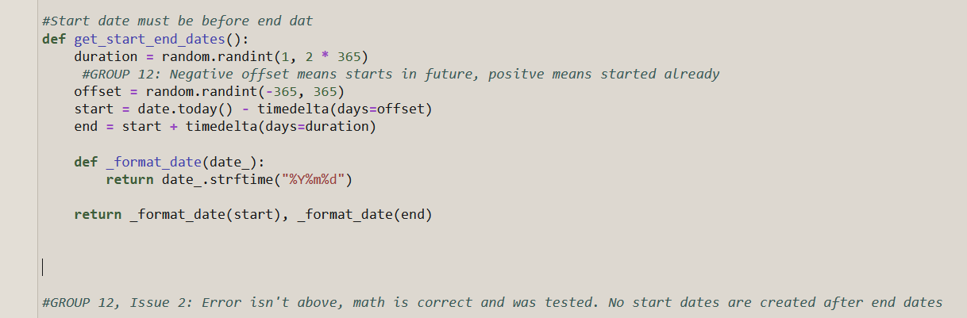
Notes:
Function for date creation is logically correct. This was tested multiple times and no end date was created before start date

Slide 12
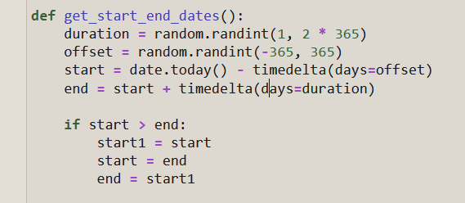
Notes:
We attempted to fix by swapping start and end around if start was sooner than end, but also didn’t fix the issue

Slide 13
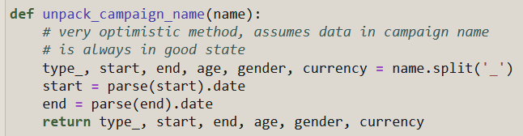
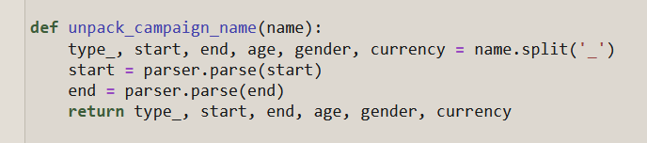
Before After
Notes:
Using a different parser, from dateutil fixed this issue. Parser parses the dates more consistently.

Slide 14
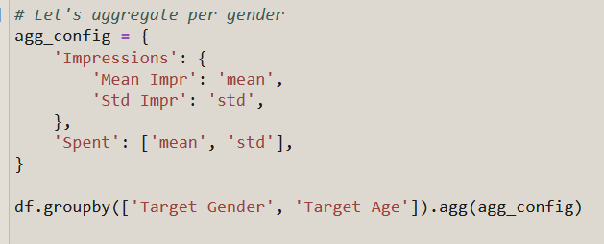
Issue 3: Nested Error
Notes:
There is a nesting error with a dictionary inside a dictionary.

Slide 15
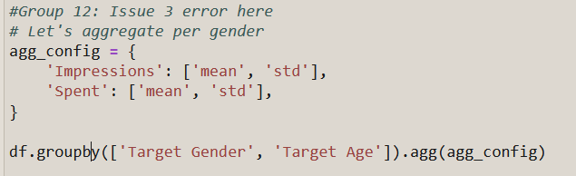
Change to:
Notes:
To fix, remove dictionary and change to a list

Slide 16
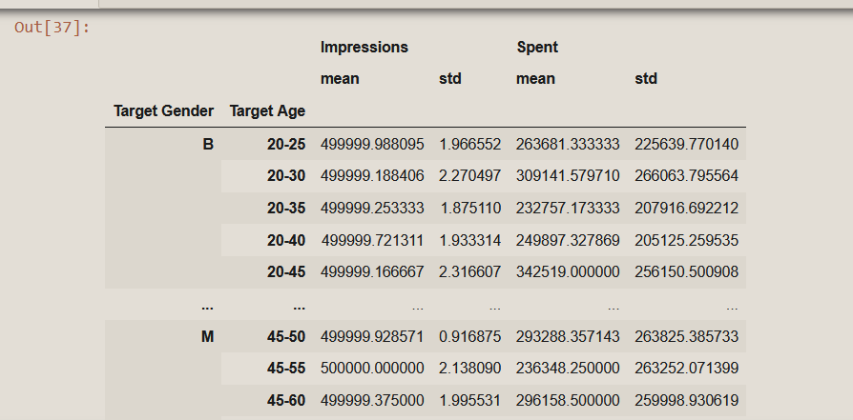
Notes:
Results of that fix

Slide 17
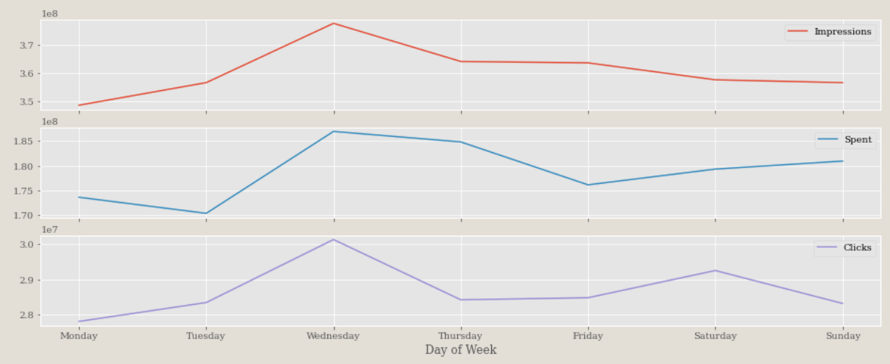
Data Visualization
Notes:
Thanks Kevin now we will take a look at the visuals for our dar
A conclusion we can make is that the data is dependant on our spend here
Showing a Direct correlation here
As a spend increases so do our impressions and clicks same thing happens when our spend decreases we receive a lower number of clicks and impressions

Slide 18
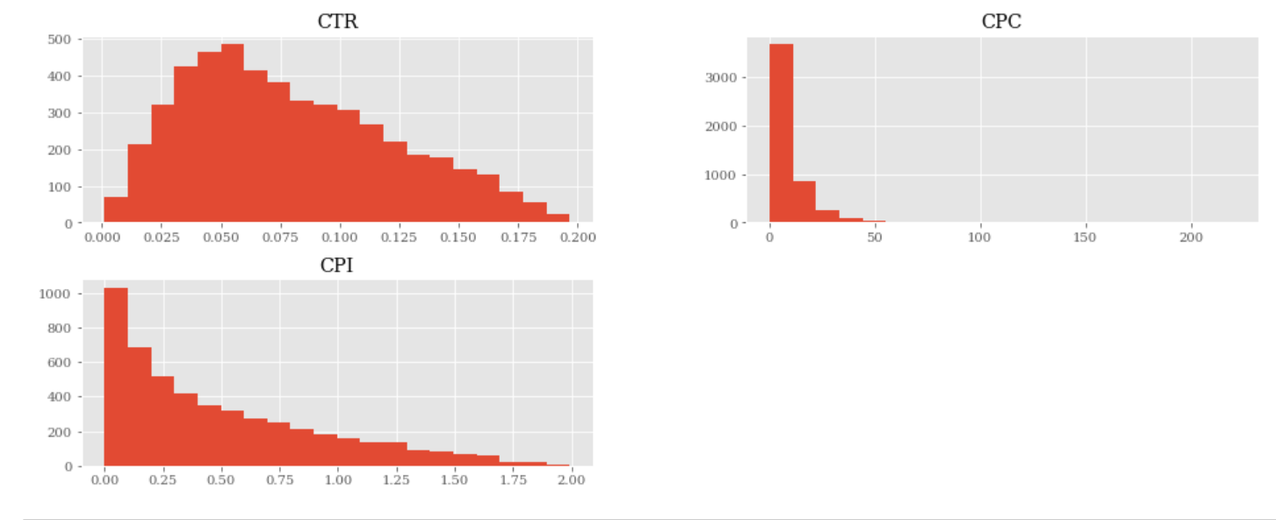
Error: Budget Not Displayed
Notes:
Fixing the issues in the code we were able to display the histograms you can see, however as you can see the budget chart is missing

Slide 19
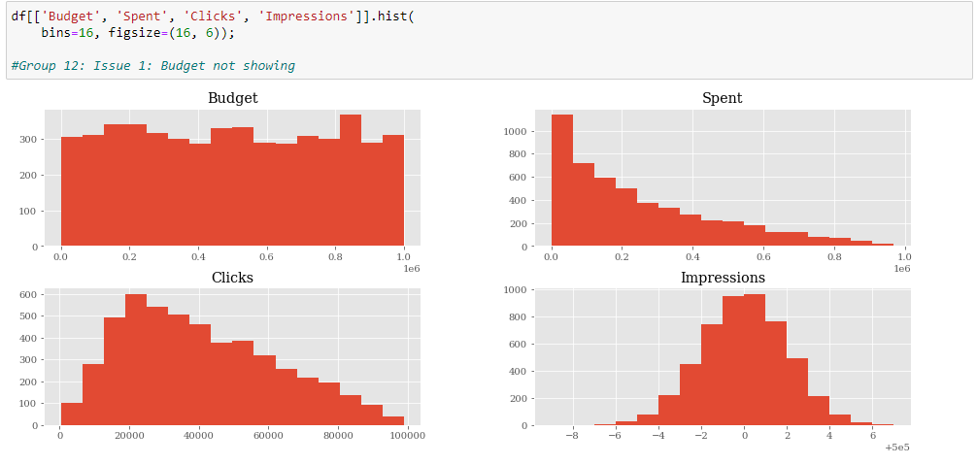
Fixed Error
Notes:
With that in mind As Kevin discussed we moved up cmp_name to the first column in the dataframe from step 3 so that the objects are consistent with the data frames from before
All histograms show the correct data, we can see as spend goes down so does clicks

Slide 20
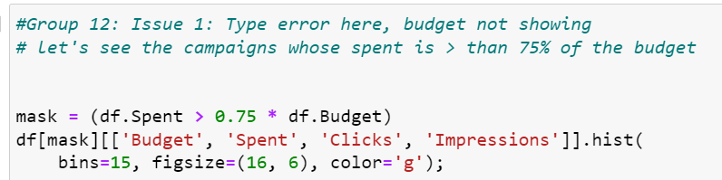
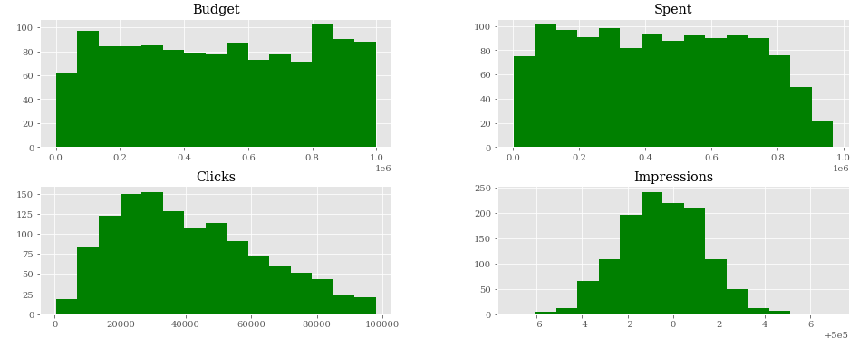
Notes:
Here the data
Displays that the portion of campaign spending is more than 75% of the budget
However, there is a discrepancy as the amount of clicks and impressions goes down
Next I will pass it along to Nafisa to

Slide 21
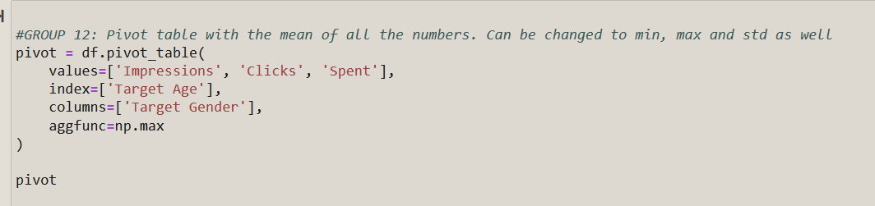
Notes:
What is a pivot table?
A pivot table is a table of statistics that summarizes the data of a more extensive table. In practical terms, a pivot table calculates a statistic on a breakdown of values. For the first column, it displays values as rows and for the second column as columns.
How can I pivot a table in pandas?
Pandas has a pivot_table function that applies a pivot on a DataFrame. It also supports aggfunc that defines the statistic to calculate when pivoting (aggfunc is np.mean by default, which calculates the average). I use the max in the example above.

Slide 22
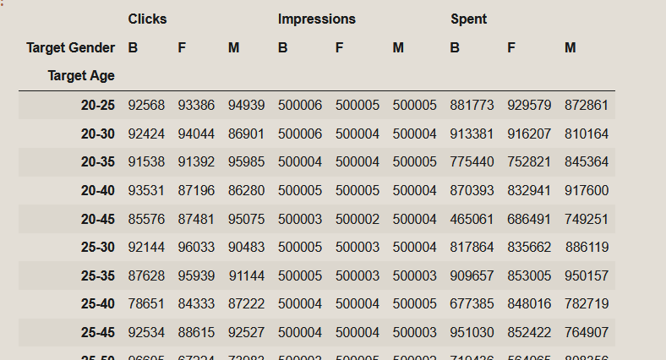
Max

Slide 23
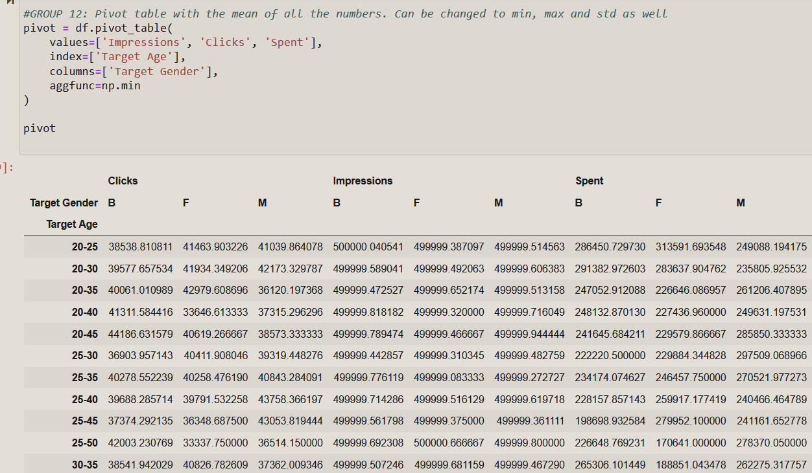
Min

Slide 24
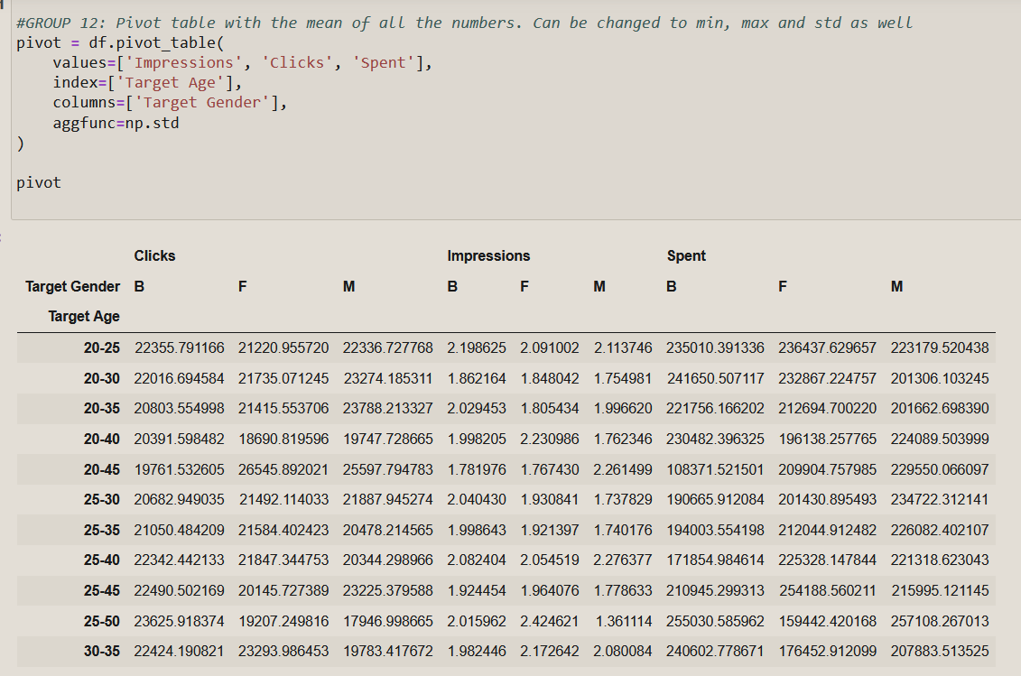
STD

Slide 25
Thank you for listening!

